Slide 1
Proof of the Power Rule for Differentiation
11 April 2023
By Ivan Novasak - Southern New Hampshire University
Notes:
Good evening. I am Ivan Novasak and I’m covering a proof of the Power Rule for Differentiation with natural number exponents.

Slide 2
Proving The Power Rule?
Statement of the Rule
Objective
Example Applied
Given a function mapping from the real numbers to the real numbers defined as f(x) = x^{n} where a is a real number, n is a natural number > 0, and the derivative of that function, called f’(x), is nx^{n-1}.
Introduce the derivative via the limit definition.
Prove the Power Rule for differentiation via the Product Rule and Induction.
f(x) = 7x⁴
f’(x) = 4*7x⁴⁻¹ = 28x³
Notes:
We first state the rule where a function f mapping the real numbers to the real numbers is defined as f(x) = x^{n}. We also shall introduce the derivative via the limit definition. An example of the power applied is shown.

Slide 3
What Is the Derivative of a Function?
Notes:
We now define the derivative via the limit definition.

Slide 4
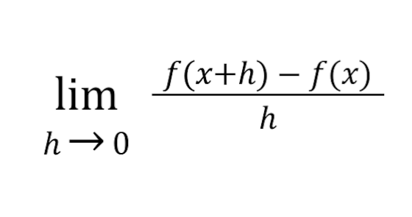
What is the Derivative of a Function?
The derivative of a function f : R →R on an open interval is defined as follows and notated f’(x):
Notes:
The derivative of a function is the limit as h approaches 0 of the expression [ f(x + h) - f(x) ] / h.

Slide 5
Proof of the Product Rule for Differentiation
Using the limit definition that was introduced in the previous slide
Notes:
Next we shall prove the Product Rule because we will use it in our proof of the Power Rule. The Product Rule is used when one needs to to take the derivative of the product of two functions.

Slide 6
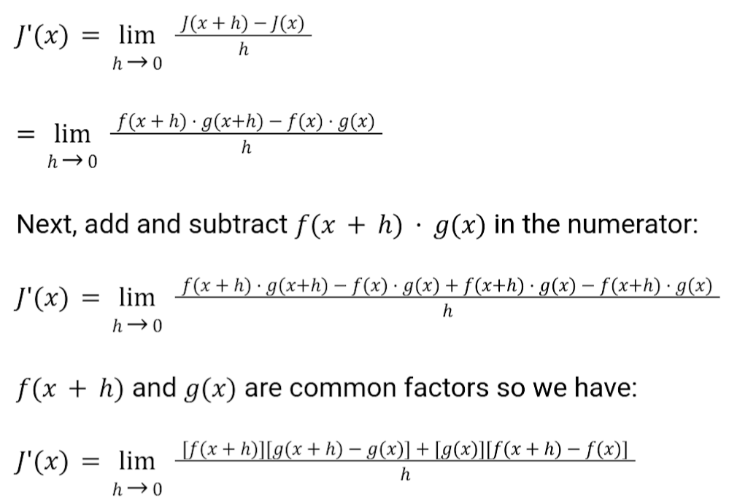
Proof of the Product Rule
Let f and g be two functions whose argument is x. Let J(x) be defined as the product of the two functions f(x)*g(x). J(x + h) = f(x + h)*g(x + h).
The derivative of the function J is as follows:
Notes:
This is page 1 of the Product Rule for differentiation. We start with defining the product as a function, then using the limit definition of the derivative to differentiate. We add and subtract f(x + h) * g(x) to get the factor we need to proceed with factoring by grouping in the numerator.

Slide 7
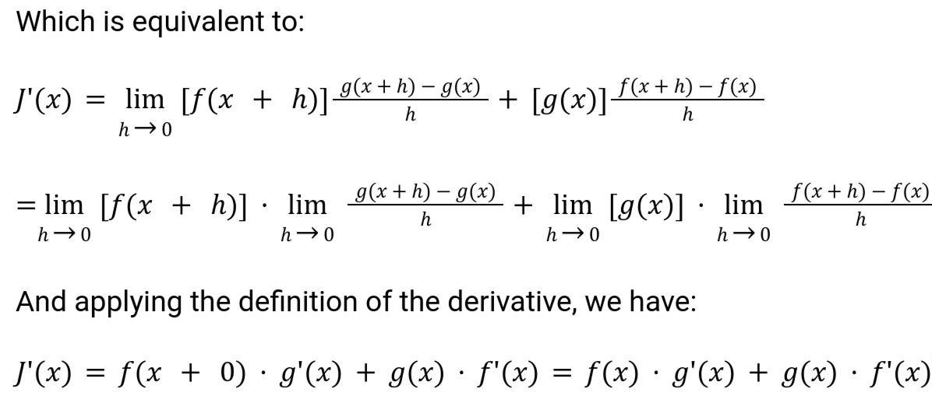
Proof of the Product Rule (Continued)
Notes:
This is page 2 of the Product Rule for differentiation, where the end result is shown. The Product Rule will be put to use when we prove the Power Rule.

Slide 8
Proof of the Power Rule for Differentiation
Via the Product Rule and Induction
Notes:
Next we shall move on to proving the Power Rule using the Product Rule and a mathematical Induction technique.

Slide 9
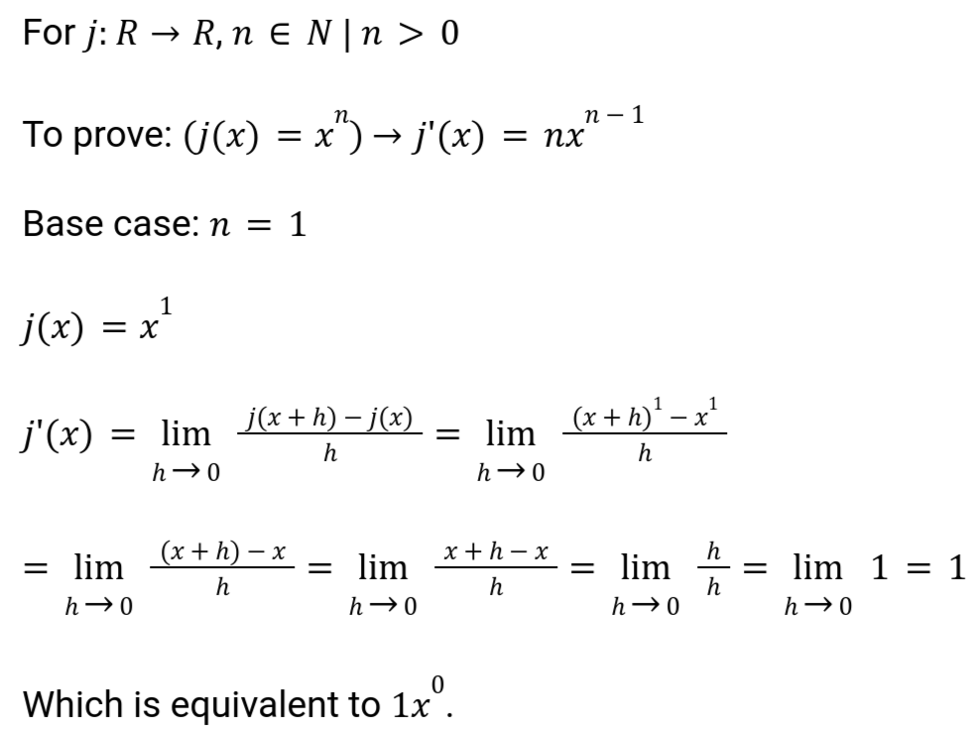
Implication & The Base Case
Notes:
First, we lay out the definition of our function j, which maps from the real numbers to the real numbers with natural number exponents such that the exponent is greater than 0. Next, we show the base case where n = 1, then take the derivative of x¹ (which = x) using the limit definition.

Slide 10
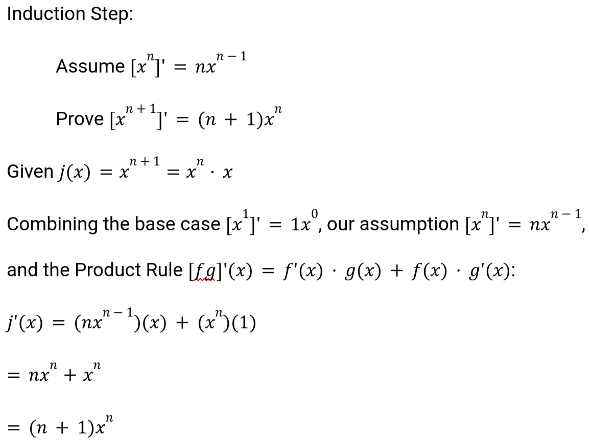
Induction Step
Notes:
Next, we make an assumption that the derivative of x^{n} = nx^{n - 1}. We will prove that the derivative of x^{n + 1} = (n + 1)x^{n}. Now we define a new function j(x) = x^{n + 1} which is equal to x * x^{n} by the exponents law. Now we combine our base case, the Product Rule, and our assumption to take the derivative of j(x). Via the Product Rule, we arrive at j’(x) = (nx^{n - 1})(x) + (x^{n})(1) which is equal to nx^{n} + x^{n}, which is equal to (n + 1)x^{n}.

Slide 11
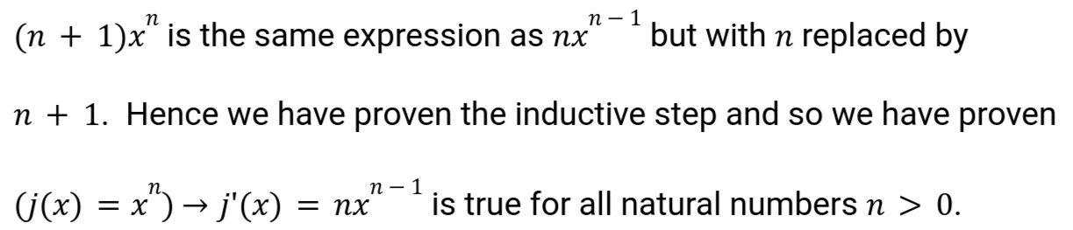
Conclusion
Notes:
Our conclusion is that (n + 1)x^{n} is the same as nx^{n - 1} but with n replaced by n + 1. So we have proven our inductive step for the derivative and so shown that it is true for n + 1, so therefore it must also be true for all natural numbers n.

Slide 12
References
Bloch, E. D. (2011). The Real Numbers and Real Analysis. Springer Science & Business Media.
Notes:
This is the textbook reference.

